Slide 1
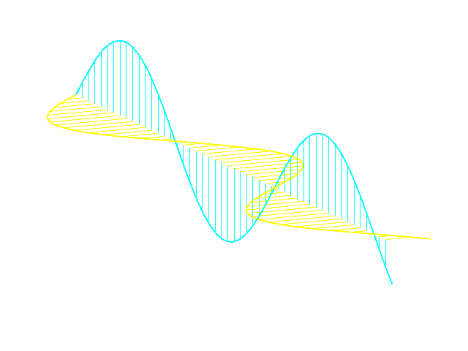
A Review of MWA Polarisation
Sam McSweeney, John Morgan,
and many, many others!!!
Notes:
Abstract: Calibrating the MWA as a dual-polarised instrument is notoriously difficult, evidenced by the fact that even our latest beam models and calibration algorithms produce solutions that demonstrably contain frequency-dependent phase errors between the two polarisations. In this talk, I will present an overview of the basic problem using a combination of intuitive and mathematical arguments, and briefly outline some of the approaches (known to me) that different groups have implemented to overcome it, including some musings on the possible role that pulsars could play in the solution. I will argue that despite the heroic efforts of multiple groups, we still lack a fundamental understanding of how the remaining phase errors are creeping into our calibration solutions in the first place. I will conclude by advocating for a more centralised approach to solving the problem, as well as to making known solutions and workarounds more accessible to the broader MWA community.
I am giving this talk on the lands of the Whadjuk Noongar people whose lands were never ceded, and would like to pay my respect to their elders past and present.
My talk is part review and part call-to-arms for solving a problem that has been lurking in the wings for years and years, and is probably affecting your data as well. As you can tell from the title slide, it has to do with MWA polarimetry, and so before getting to the problem itself, I’ve got to start with a quick primer on polarisation.

Slide 2
What is polarisation, and why do we care?
Electric field
Magnetic field
Notes:
We’ll all be familiar with the textbook illustration of a propagating EM wave, where the electric field oscillates at some arbitrary frequency, and the magnetic field oscillates perpendicularly to the electric field, and the oscillations propagate in some direction at the speed of light. All of this drops right out of Maxwell’s Equations. Of course, there’s nothing special about the orientation I’ve chosen for the electric and magnetic fields…

Slide 3
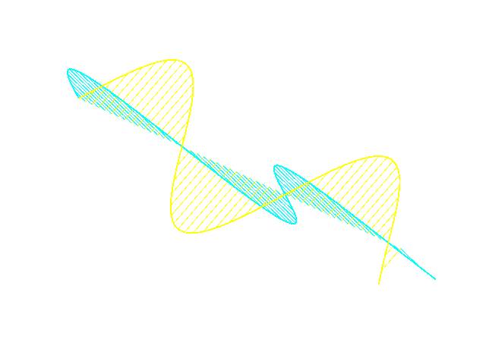
What is polarisation, and why do we care?
Electric field
Magnetic field
Notes:
…I could equally well have chosen this picture instead. Things get interesting when you play around with another property of EM waves, namely, that you can superpose them, which is to say, that you can add the vectors of two electromagnetic waves at each point in space and time, and the result you get is guaranteed to also be a solution of Maxwell’s equations. For example, if you add together one wave where the electric field is propagating in one plane, and another wave where the electric field is propagating in another plane perpendicular to the first one, and if the second one is retarded by a quarter of a phase relative to the first one, you can get…

Slide 4
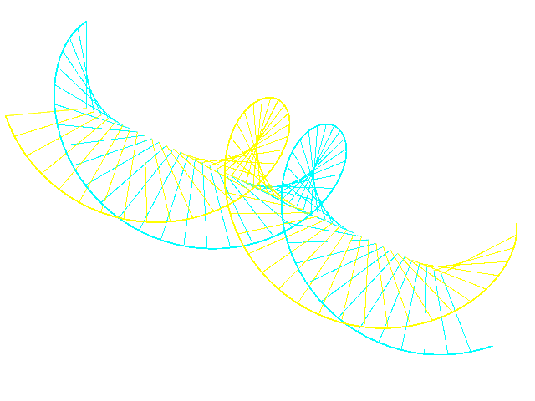
What is polarisation, and why do we care?
Electric field
Magnetic field
Notes:
…really cool-looking waves like this. But what is the full range of possibilities?
Let’s first make it easier for ourselves by ignoring the magnetic field, …

Slide 5
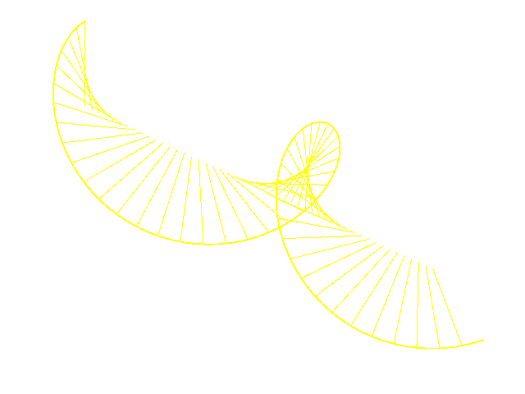
What is polarisation, and why do we care?
Electric field
Notes:
…which we can do because Maxwell’s equations tell us how to reconstruct the magnetic field from a time-varying electric field, so in the context of electromagnetic waves in a vacuum, it’s redundant information.
This animation represents how the wave might be propagating through 3D space (in this case, along this long axis), but in practice, we never get to sample the electric field everywhere, but only in one spot, say, wherever we place some kind of measuring device, like our eye. So from the detector’s rather limited point of view…

Slide 6
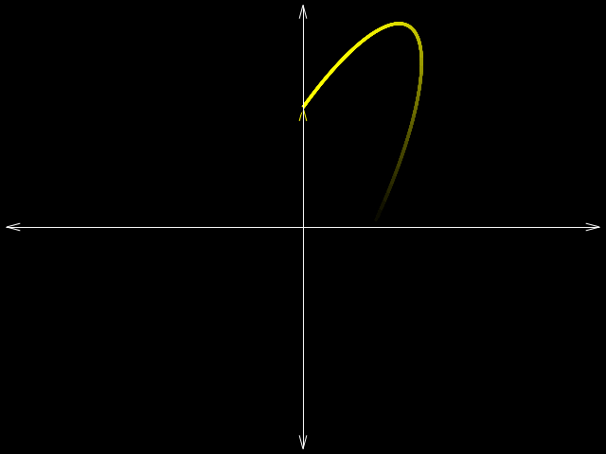
What is polarisation, and why do we care?
Electric field
Notes:
…it would only “see” the electric field vector at one point tracing out some shape in the plane perpendicular to the direction of propagation. What shapes are possible? At a single frequency, the most general shape is an ellipse, and we collectively call the eccentricity and orientation of the ellipse, the “polarisation state”. The terms “linear” and “circular” polarisation are just two special cases, “linear” being an ellipse with eccentricity “one” (i.e. the electric field vector just oscillates along some particular line), and “circular” being an ellipse with eccentricity “zero”, (i.e. the electric field vector just traces out a circle).
Things get more complicated when you start to superpose waves with different frequencies, because the resulting trace of the electric field at a given point in space is no longer constrained to an ellipse.
In fact, if you choose random polarisation states for each frequency over some range, you end up with the electric field vector following a random path in the perpendicular plane.
[Click to show distribution example]
To describe this kind of light, instead of looking at how the electric field evolves instantaneously over time, we instead look some of its low-order statistics, over some finite time and/or frequency range.

Slide 7
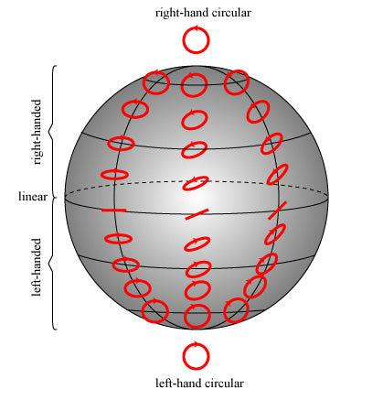
Stokes parameters: the language of statistical polarisation properties
Parameter name
I
Q
U
V
Notes:
These statistics are called Stokes parameters, but in the interests of time, I’m afraid I can only spare one quick slide to explain them.
For this talk, the main things you need to know is that Stokes I is total power, Stokes Q and U describe the linear polarisation component (and its orientation), and Stokes V describes the circular polarisation.

Slide 8
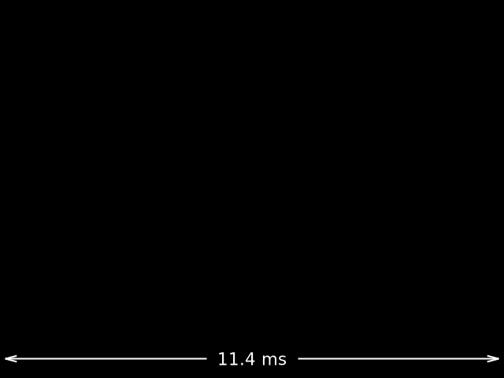
A motivating example from the 1960’s
Notes:
Why do we care about polarisation? I only have time to give one motivating example of how you can do astrophysics with polarisation, so, because it’s me giving this talk, I’ll pick an example from pulsars.
[Click to make profile animation appear.]
Here is an example of an light curve of a pulsar, averaged over many pulses. This light curve is the total intensity, or Stokes I.
This was one of the earliest pulsars to be discovered, and when they looked at its polarisation properties …

Slide 9
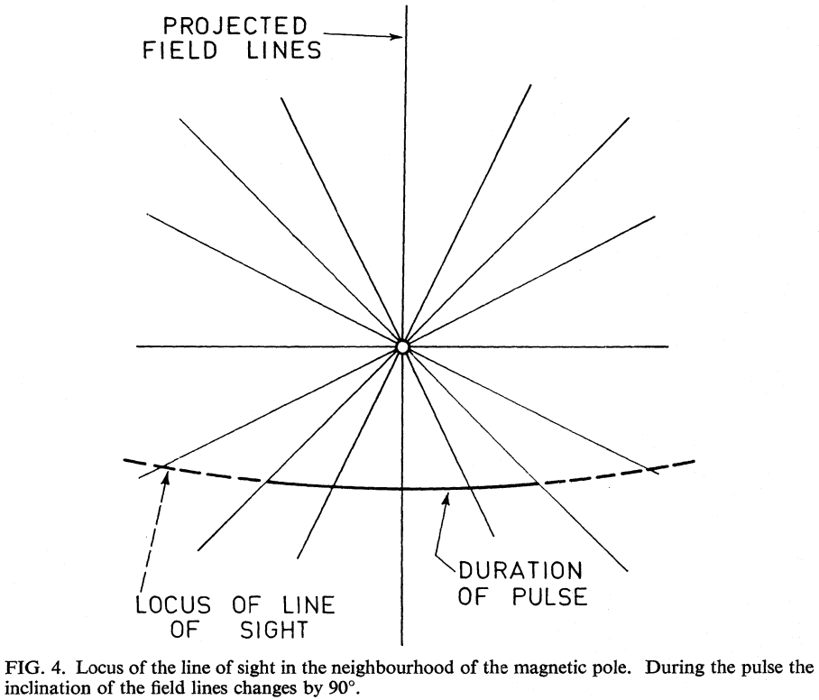
A motivating example from the 1960’s
Notes:
…they saw (1) that the intrinsic polarisation state was strongly linearly polarised, and (2) that the angle of the polarisation ellipse changed smoothly as a function of the pulsar’s rotation.
[Click for Fig. 4 to appear]
They hypothesised that the angle of the polarisation was associated with the projected angle of the pulsar’s dipolar magnetic field lines that through under the observer’s line of sight. Hence, they inferred that the emission must be arising from a region around the pulsar which was far enough from the surface so that dipolar component of its magnetic field dominated, but not so high that the magnetic field could no longer corotate with the pulsar without violating special relativity.
This is a spectacular demonstration of how polarisation constrains pulsar electrodynamics.

Slide 10
Detecting polarisation
Electric field
Notes:
So, given that we care about polarisation, what does it take to get a full measurement of the polarisation state of a source? For this discussion, I’m just going to go back to the monochromatic case, where the light is always 100% polarised, and the electric vector traces out an ellipse.
If you happen to have a dipole antenna, you could position it in some orientation, say, the horizontal direction, …

Slide 11
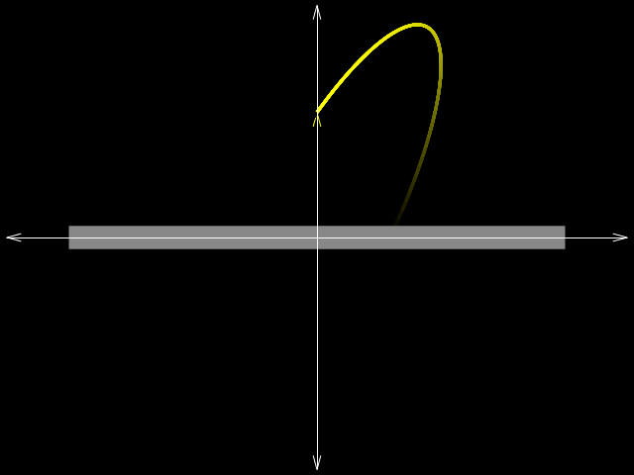
Detecting polarisation
Electric field
Notes:
…and what you’ll get is the incident electric field generating a voltage across the dipole which is proportional to the component of the incident field projected onto the dipole. With a second dipole oriented vertically, …

Slide 12
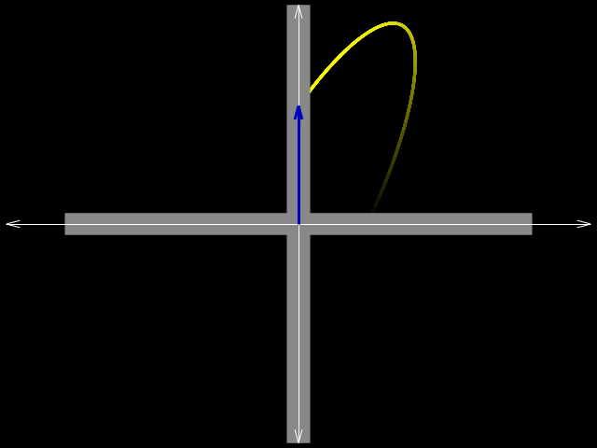
Detecting polarisation
Electric field
Notes:
…you can sample both the horizontal and vertical components of the electric field. As long as you keep track of the relative phase offset between the voltage response for the two dipoles, you can perfectly reconstruct the incident electric field.
Now, really, the premise of this whole talk is the following statement: Keeping track of the relative phase offset between the two dipoles is hard.
What happens if you do get the phase offset between the two dipoles wrong?

Slide 13
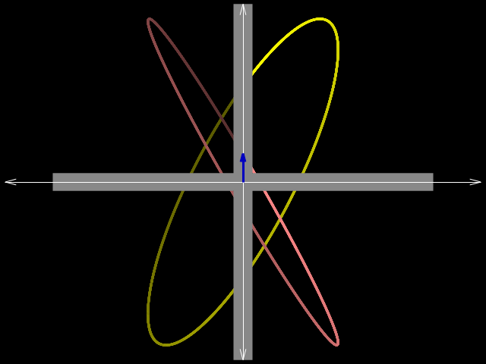
Detecting polarisation
Electric field
Inferred electric field
Notes:
You would infer the wrong polarisation state.
How do we avoid this? By a process of calibration, of course. If you have a known source of polarised light, and if you have a model of how your receiving elements should respond to that incident light, you can predict what the amplitudes and relative phase difference should be, and then compare your prediction to what you actually measure, and adjust things accordingly.
What we want, then, is a so-called “calibration solution”, which means the set of amplitude and phase corrections you need to apply to your voltage measurements to make your inferred electric field match the true incident electric field.

Slide 14
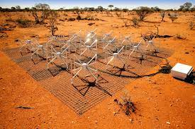
Calibration
010110001010110110101011010010001010101111101010101001010010100100000011010101001010110011011010111100001011110001001100
MWA data
Beam model
Sky
model
Calibration software
Calibration solution
Notes:
Now, we have calibration software for doing all this, BUT the calibration solutions we are getting out of our MWA pipelines are known to be wrong. Ok, maybe that’s a bit strong.
What I really should say is: “Some of the calibration solutions that we are getting out of some of our MWA pipelines are known to be wrong.”
[Click to make graphic appear]
Here is a schematic of how all MWA calibration pipelines work. There are three basic ingredients:
[Click] (1) Actual data recorded from the telescope;
[Click] (2) A model of how the front-end part of the telescope actually responds to incident radiation from different directions, where “front-end” here includes both the antenna elements themselves, as well as the analogue beamformer which makes the primary beam; and
[Click] (3) A model of what you expect the sky to actually look like, so that you can actually make a prediction of what your data should look like. All of these ingredients get fed into some calibration software, which spits out a set of solutions.
Now, if the calibration solutions you are getting are incorrect, …

Slide 15
What is going wrong?
010110001010110110101011010010001010101111101010101001010010100100000011010101001010110011011010111100001011110001001100
MWA data
Beam model
Sky
model
Calibration software
Calibration solution
Notes:
…then it could be any of these components highlighted in red that could be at fault. Your beam model could be wrong, your sky model could be wrong, or you might even simply have a bug in your software. (It doesn’t make sense to say that the data could be wrong because, of course, we knew it was wrong at the outset. Finding out how it’s wrong is the whole point of the exercise.)
So keep these possibilities in mind when, in a minute, I show you an example of data to which a faulty calibration solution has been applied.
This example is from the Pulsar group, but I know of examples with similar symptoms from the GEG group and the EoR group as well.
Of course, with any particular example, I have to be upfront about which beam model was used, which sky model was used, and which calibration software was used.

Slide 16
One example
FEE Beam (Sokolowski et al. 2017)
Only total intensity (Stokes I) of brightest sources within the primary beam
RTS (Mitchell et al. 2008; Ord et al. 2019)
Beam model
Sky
model
Calibration software
Notes:
This example used the [click] FEE beam, [click] a Stokes I sky model, and [click] the RTS calibration package. If you’re suspicious of our use of the RTS (which you should be!) rest assured that I could show other examples where different calibration software was used. This example is just one I had on hand while preparing this talk.

Slide 17
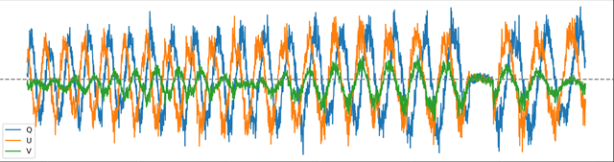
One example (PSR B0628-28)
Flagged channel
Power (a.u.)
140
Frequency (MHz)
170
Plot credit: Mengyao Xue
Q
U
V
Notes:
This is a plot of how the measured polarisation state of a pulsar changes as a function of observing frequency. I’m betting most people looking at this plot will not immediately be able to see that something is wrong, so I’ll take you through it briefly. What you’d expect to see from a pulsar, after the intervening interstellar medium has had its Faraday rotation way with it, is a set of oscillating Stokes Q and U (which is there in blue and orange), and a mostly constant Stokes V. However, it looks like V is oscillating in a similar way, which is something Faraday rotation absolutely can’t explain. This is strong evidence that polarisation leakage has occurred, which in turn indicates that something has gone awry with the calibration solution that was used in this case.
Having identified that there is an issue, the problem is now to use the measured polarisation to deduce the error in the calibration solution that caused this leakage. As Natasha mentioned during Dev’s talk yesterday, this exercise has been done, with a lot of hard work, …

Slide 18
The GLEAM solution
Δφ = 0.44° + 28°
data_id | ra | dec | polint | rm
GLEAM J153150+240244 | 232.96013 | 24.0331 | 0.363536 | 11.731
GLEAM J121834-101851 | 184.64228 | -10.31118 | 0.711955 | -8.159
GLEAM J063633-204225 | 99.14097 | -20.70861 | 1.104038 | 50.286
GLEAM J041340+111209 | 63.44819 | 11.19557 | 0.389896 | -13.351
GLEAM J035140-274354 | 57.94213 | -27.71584 | 0.519881 | 33.59
( )
ν
MHz
https://wiki.mwatelescope.org/display/MP/Polarimetry
Notes:
…by the GLEAM team, with the lion’s share of the work done by Xiang, but with contributions from a lot of other people right across the MWA collaboration. I don’t really have time to explain the process here, except to say that Xiang was able to map the measurable leakage between U and V directly to an extra phase offset that you need to apply to the signal of one polarisation, according to this low-order fitted formula, which is also published on the MWA wiki at the URL on the slide.
A few comments about this solution. First, across 30 MHz, that equates to about 13.5 degrees, so this can understandably lead to significant leakage somewhere in your band if you don’t correct for it. Another point is mainly directed to those of you who might be worrying that the constant offset here of 28 degrees is indicative of a non-delay like effect – this isn’t necessarily the case, because this is an exact solution to very imprecise data with a relatively short lever arm, and it is likely that the intercept at zero frequency is actually consistent with zero phase within errors. But if you’re interested in that kind of thing, ask me privately later if you wanna see evidence that the phase offsets in the calibration solutions really aren’t delay-like!!

Slide 19
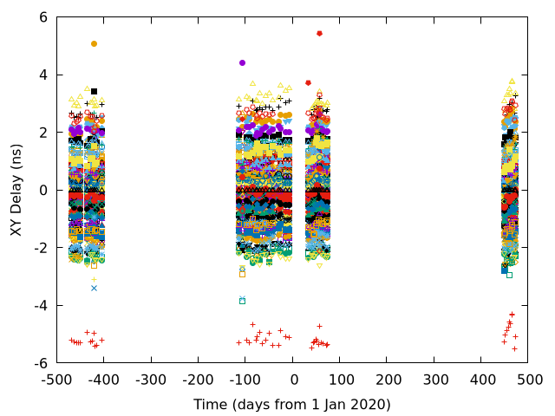
The generality(?) of the GLEAM solution
Different point shapes/colours = different MWA tiles
Plotting slopes of fits to calibration solutions, but expressed in terms of “equivalent time delay between the two polarisations”
Everything relative to tile HexS36 (black triangles at Delay = 0)
Notes:
Now that the GLEAM team have published this solution, the natural question is: can anybody just take this solution and apply it to their calibration solutions and expect that the leakage will largely go away? And the answer to that is definitely… “it depends”. On one hand, the GLEAM team found that they were able to apply the same solution to observations spanning years (from ~2018 to ~2020), so it seems that whatever the cause of the leakage is, it appears to be stable in time. I have also independently verified this stability (although not GLEAM’s specific solution) for a set of VCS observations taken for the SMART pulsar survey, using the Phase II compact configuration.
[Click] Here is a plot of the relative phase differences between the E-W and N-S arms (i.e. polarisations) of each MWA tile, or rather, the slopes of those phase differences across the 140 - 170 MHz band, expressed in terms of an equivalent time delay between the two polarisations. As you can see, those phase differences remain stable across years, with the possible exception of the clump of most recent observations in 2021, where there seems to be a systematic change in the delay. But actually, since all of these are plotted relative to one specific tile, it’s far more likely that just that one tile was doing something funky during that time period, while all the others still stayed relatively constant.
On the whole, though it looks like the phase offsets are indeed very stable in time. But even then we can’t necessarily say that the GLEAM phase correction is a panacea for all polarisation leakage problems, because it still depends on how the phase error is getting into the calibration solutions in the first place.

Slide 20
The generality(?) of the GLEAM solution
010110001010110110101011010010001010101111101010101001010010100100000011010101001010110011011010111100001011110001001100
MWA data
Beam model
Sky
model
Calibration software
Analytic
AEE (Sutinjo et al. 2015)
FEE (Sokolowski et al. 2017)
Calibration solution
Notes:
If, for example, the extra phase is there because of inaccuracies in the beam model, then yeah, sure, anyone using the same beam model will probably find the same error in their calibration solutions and can apply the GLEAM solution. But could it just be the beam model? For the GLEAM data, which only uses meridian pointings, you might be able to imagine a scenario where the beam is systematically wrong, but, actually, the SMART observations I showed on the previous slide used different calibrator fields for different observations at different times, so it seems that, if the problem is in the beam model, then either it doesn’t depend on where you point the primary beam (which to me seems unlikely), or this is evidence that this phase error is not actually due to the beam model.
I should say, at this point, that a lot of work has gone into characterising the polarimetric response of the MWA primary beam, by Emil Lenc, Jack Line, Atul Chokshi, Adrian Sutinjo, to name just a few. Work before the FEE beam model became available in 2016 obviously could not compare their results with the FEE beam, and I believe there are several researchers who are actively working on this to get a better sense of how correct the FEE beam is, particular with regards to polarisation.

Slide 21
The generality(?) of the GLEAM solution
010110001010110110101011010010001010101111101010101001010010100100000011010101001010110011011010111100001011110001001100
MWA visibilities
Beam model
Sky
model
Calibration software
“Although it is sometimes asserted that this phase can only be constrained by calibrating to a polarised source…, in the widefield limit the non-orthogonality of the instrumental polarisation basis couples appreciable unpolarised source power into the cross-polarisation visibilities.”
—Byrne et al. (2022)
Calibration solution
Notes:
Ok, well what about the sky model? The possibility that the error is in the sky model is an interesting one. For a long time, I was under the misconception that you couldn’t expect to get the phase difference correct between the N-S and E-W dipoles if your sky model only consists of Stokes I sources. That turns out to be generally untrue for the MWA. One explanation I’ve heard floating around is that the primary beam itself induces a kind of pseudo polarisation on the sky, so that even unpolarised sources “look” polarised, except in certain situations, such as when the source is at zenith. The explanation given in the FHD paper is this [read excerpt]. If you still remain unconvinced of this, come and talk to me after, and I’ll give you my own take on it.
Anyway, the long and the short of it is that, if the fact that the models are Stokes I models cannot explain the phase error we’re seeing, then it seems really hard to imagine any other way to get a systematic, time-stable phase error from an incorrect sky model. If anyone knows of one, I’d be interested to hear it!

Slide 22
The generality(?) of the GLEAM solution
010110001010110110101011010010001010101111101010101001010010100100000011010101001010110011011010111100001011110001001100
MWA data
Beam model
Sky
model
Calibration software
RTS (deprecated)
calibrate
hyperdrive
FHD
Calibration solution
Notes:
Finally, if the error is in the calibration software, then again it seems likely that the same solution would work for anyone using the same software, which in this case happens to be Andre’s calibrate. A point against this being where the error is, is the fact that I previously mentioned, which is that leakage at similar levels is found in data using other calibration software. What hasn’t actually been verified by anyone, as far as I’m aware, is whether or not different calibration software produces the same, or different, phase errors.
It will also be interesting to compare results with the FHD pipeline developed by and for the EoR group based in the US. The reason is that the underlying calibration algorithm is different to what’s used in the RTS, calibrate, and Hyperdrive. Although all of the algorithms should, by design, converge on the correct phase offset between the N-S and E-W dipoles, FHD implements this as a separate, distinct operation which it does only after the N-S dipoles have been separately, independently calibrated, and the E-W dipoles have been separately, independently calibrated. So, if it turns out that calibration solutions produced by FHD don’t exhibit the kind of frequency-dependent leakage that we’ve been discussing, then that would warrant a deeper comparison of the algorithms, and a very close look at the implementations.

Slide 23
The generality(?) of the GLEAM solution
010110001010110110101011010010001010101111101010101001010010100100000011010101001010110011011010111100001011110001001100
MWA data
Beam model
Sky
model
Calibration software
Calibration solution
Notes:
So now we seem to be in a bit of a weird situation. By all accounts, the phase error embedded in our calibration solutions, which, again, seems to be stable in time and have a frequency dependence, finds no easily explanation in terms of the beam model, the sky model, or the calibration software. And it makes no sense to blame the data, or to talk about signal path delays embedded in the MWA backend: like I said before, the whole point of these calibration schemes is to find and correct for these kinds of errors. If the calibration fails to account for this phase error, then it’s tautological to say that it must be the calibration that is at fault.
Without knowing where this error is coming from, it’s impossible to say whether or not the GLEAM correction can be applied to other calibration solutions that were processed in a different way. Of course, what we can say is that GLEAM has demonstrated how someone might measure the phase correction using their own data and their own pipelines, so I guess you could say that the problem is solved, but not really in a practical way that is easy for other groups to verify and adapt. Doing so is, I’d say, of paramount importance to all MWA users who are interested in having confidence that their polarisation measurements are correct.

Slide 24
Pathways forward
Meh, we’ll fix it in post
Fix the bug at the source!
What shall it be?
Notes:
To me, there seems to be two routes we could go down.
[Click]
Route number one is to say “ok, we know there’s a problem with our calibration solutions, but we don’t really care about how it got there because we know how to quantify it and correct for it,” thanks to the GLEAM team’s heroic efforts. But to me, this feels essentially like doing calibration twice. Once using established but buggy pipelines, and then once again “by hand”. So I’m not really a fan of this route, but it will become the de facto option, unless…
[Click]
…we actually invest the time to find out where this phase error is coming from, and solving it in the calibration pipelines themselves. The trouble is, no one individual or group is actually tasked to do this, and of course nobody has time. And even though giving a talk like this is basically shouting “pick me! pick me!”, I also really don’t have time, as my current contract is finishing up in a couple of months and then I’ll be working with Natasha on ultra-long period sources using data to which the phase correction has already been applied, so… there goes my motivation!
But anyway, these are the two options, so my question to the collaboration is – what shall it be?

